Slide 1
LFRI: Efficient Routing Emulation for LEO Mega Constellations
Wenhao Lu, Zhiyuan Wang, Shan Zhang, Hongbin Luo
Beihang University

Slide 2
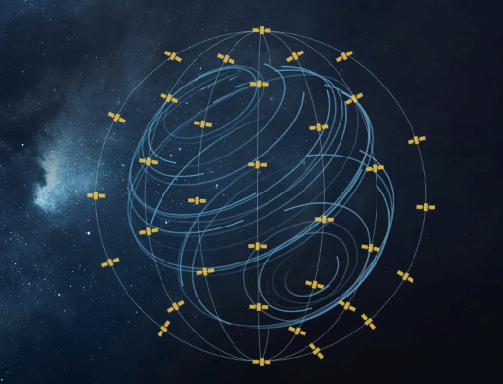


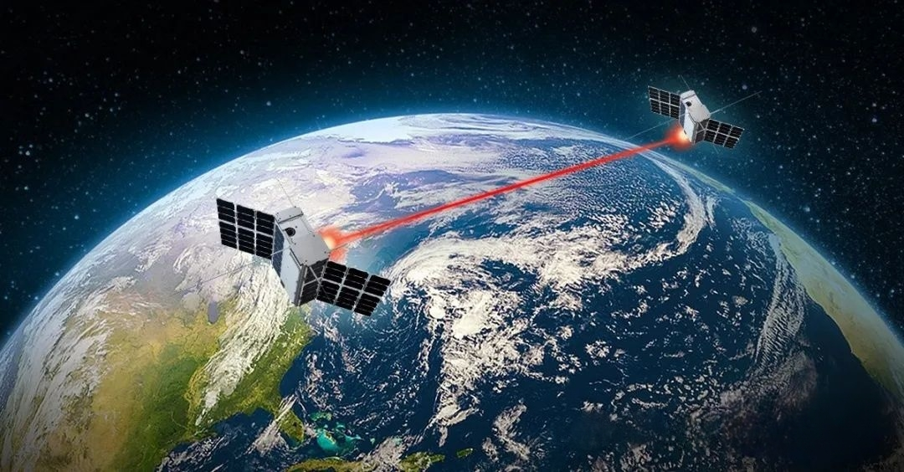
Background
With the rapid development of low Earth orbit satellite networks, the demand for inter-satellite networking and routing has become increasingly urgent.
Iridium
Kuiper
Starlink
Laser Inter-Satellite Link
Virtual network emulation has matured and has become a prevalent approach for network validation.
Virtual Network
Construction
Routing Protocol
Execution
Virtual Network
Cleaning
However, Existing container-based satellite network emulators focus on optimizing the virtual network efficiency, but overlooks the route installation latency.

Slide 3
Motivation
The route installation latency -- the duration of installing computed routes into kernel routing table – has been overlooked. This Introduces a significant bottleneck in the highly dynamic topology scenarios.
Polar Link Switching
Loss of Lock
Line-of-Sight Obstruction
Frequent Topology Change & Routing Reconvergence
Massive, High Frequent Table Entry Installation
…
This bottleneck not only hampers real-time responsiveness but also introduces significant anomalies during network emulation.
Distortion Effect on Evaluation
  Latency significantly higher than normal
  Overshadows the impact of other factors
  Compromising the authenticity and reliability
Constellation | Average Routing Calculation Time | Table Entry Installation Time
OneWeb | 42ms | 9393ms
Kuiper | 59ms | 32929ms
Starlink | 76ms | 64904ms

Slide 4

Motivation
Simply modifying design of the interface between the routing software and the installation mechanism cannot resolve the latency-dynamics mismatch.
Synchronous Installation
Asynchronous Installation
Aware
Link State
Change
Aware
Link State
Change
Route Buffer
Table Entry Installation
Route
Recalculate
Block Following
Procedures
Route
Recalculate
Table Entry Installation
Core Issue: Produce Speed >> Consume Speed
Fixed-Length Buffer: Route loss occurs when the buffer is full.
Variable-Length Buffer: Uncontrollable overhead and installation latency
Virtual Network Emulation Needs a High-Speed Table Entry Installation Method

Slide 5
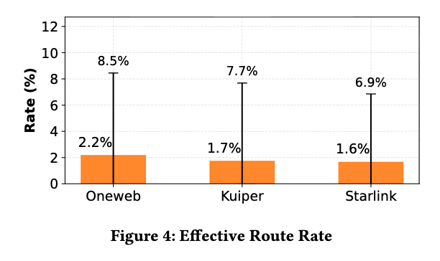
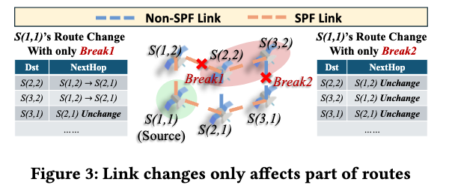
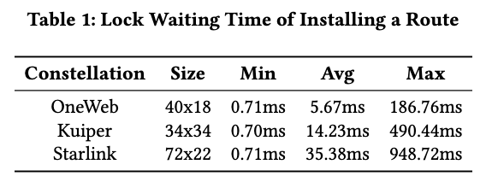
Contributing Factors Analysis
Two factors of latency: Redundant installation & Non-concurrent mechanism
Factor 1: Redundant Installation Operations
Factor 2: Concurrent incapable RTNetlink
Network scales up & Routing table expand => Installation latency increases exponentially.
Container1
Container2
Container3
Container4
ContainerN
Routing Software
Routing Software
Routing Software
Routing Software
…
Routing Software
rtnl_lock() – Kernel Level Mutex
Serial Table Entry Installation

Slide 6
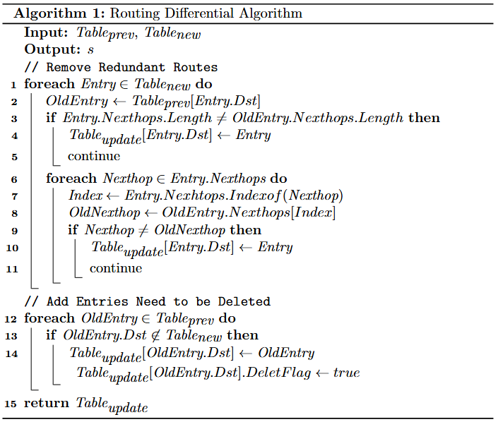
Optimization I: Routing Entry Diff Mechanism
Stateless Routing Installation Brings Redundant Installation Operations
Has NO impact to the kernel routing table
Incurs additional overhead & latency
Dst | Nexthops | Preference
Dst1 | Nexthop1 | 1
 | Nexthop2 | 2
 | Nexthop3 | 3
Dst2 | Nexthop1 | 1
 | Nexthop2 | 2
Non-Effective Route Filter Mechanism
Update Entries
Dst | Nexthops | Preference
Dst2 | Nexthop1 | 1
 | Nexthop2 | 2
Dst | Nexthops | Preference
Dst1 | Nexthop2 | 1
 | Nexthop3 | 2
Same as Old Entry, Ignore
Delete Nexthop, Apply
Dst | Nexthops | Preference
Dst2 | Nexthop2 | 1
 | Nexthop1 | 2
Dst | Nexthops | Preference
Dst1 | Nexthop4 | 1
 | Nexthop1 | 2
Routing Entry Diff Algorithm
Preference Change, Apply
Nexthop Change, Apply

Slide 7
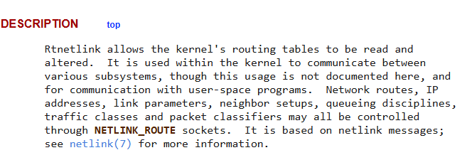

Optimization II: Lock-Free Table Entry Installation Mechanism
Why RTNetlink use Kernel Level RTNL_Mutex
RTNetlink: A comprehensive network management interface
Physical Link，Network Namespace need kernel level mutex
Independent routing tables in virtual nodes natively Isolated
Kernel-level mutex not only ineffective but also introduces significant overhead.
Lock-Free Route Installation Mechanism
Bypass RTNetlink & FIB Table
Achieve this goal with native kernel feature
Design Lock-Free Table Entry Installation Mechanism with eBPF
Kernel Native
Data Plane Processor
Replace
Per-Container
Forward Table
(Isolated)
Replace
Classic Route Table
(With Kernel Mutex)
Netfilter Forward Chain

Slide 8
Compatibility Considerations: Minimal Disruption to Existing Software
Minimize the Disruption to Existing Software
Compatibility is non-ignorable
Exist many rich feature routing software
Netlink is the most common interface to install route
A similar api for this method is necessary
High-Speed Table Entry Installation Framework

Slide 9
Evaluation: System Overhead
Reduce Emulation System Overhead
Order-of-magnitude reduction in cache misses during route installation
Effectively shortens the task waiting queue length

Slide 10
Evaluation: Route Installation Latency
Reduce Route Installation Latency
Metrics: Installation latency of a batch of route which generated by each routing calculation
Filtering non-effective routes significantly reduces route installation latency
Lock-free installation method achieves an order-of-magnitude reduction in latency
Combining both methods lowers the latency to less than 1% of the original level

Slide 11
Case Study: Path Available Ratio
Enhances the consistency of repeated experimental results.
Traditional method: experimental results exhibit high variance and significant data dispersion
Our method: tightly clustered experimental results with high consistency
Reason: path recovery time is constrained by unoptimized route installation latency, high mean delay and large variance.
Our method optimizes route installation latency, restoring the expected distribution of path recovery time.

Slide 12
Thank You !
Wenhao Lu
Beihang University
luwenhao_2001@outlook.com

